Slide 1
Qualitative Research Is Child’s Play: An Experiential Workshop
Ron Chenail, Ph.D.
Razor’s Edge Research Scholars
February 4, 2017

Slide 2
Abstract
In this experiential workshop, I will introduce you to qualitative research and qualitative data analysis through a series of painful playful exercises.
I say qualitative research is child’s play because I will ask you to draw upon competencies you have already mastered from childhood…and to have fun.

Slide 3
What is qualitative research?
(I will try to make this part of the workshop interesting)

Slide 4
Qualitative Research
Qualitative research is the rigorous attempt to produce findings or results by describing, explaining and/or interpreting qualitative patterns in terms of words, numbers, matrices, pictures, sounds, or other forms of representation.
Qualitative research is well-suited for naturalistic inquiry, discovery-oriented studies, learning perspectives of others, and for studying complex and natural phenomena.
Definition

Slide 5
Qualitative Research
Naturalistic Inquiry
Discovery-Oriented
Learning from Others
Complex Phenomena
Iterative and Circular
Qualities

Slide 6
Qualitative Research
Inductive / Deductive / Abductive
Subjective / Objective
Generative / Verifying
Constructive / Enumerative
Descriptive / Interpretive
Artistic / Scientific / Critical
Assumptions

Slide 7
Qualitative Research
Ethnography
Phenomenology
Grounded Theory
Narrative Inquiry
Discourse Analysis
Case Study
Autoethnography
Portraiture
Action Research
Mixed Methods
Types

Slide 8
Qualitative Data Analysis
Qualitative data analysis is the rigorous process of selecting qualitatively distinct data, articulating the qualitative meaning ascribed to those units, and commenting on the qualitative similarities and differences noted between and among these distinct units of data.
Definition

Slide 9
Qualitative Data Analysis
The goal of qualitative data analysis can be to describe, explain, and/or interpret qualitative patterns in terms of words, numbers, matrices, pictures, sounds, or other forms of representation.
Definition

Slide 10
Qualitative Data
Words
Objects
Feelings
Actions
Rituals
Experiences
Perspectives
Impressions
Events
Artifacts
Symbols
Types

Slide 11
Qualitative Data
Interviews and Transcripts
Observations and Fieldnotes
Documents
Pictures and Images
Audio and Visual Recordings
Sources

Slide 12
Qualitative Data Analysis
Generating and Collecting
Preparing and Processing
Analysis
Metaphoric
Abstraction
Recursive
Transformative
Process

Slide 13
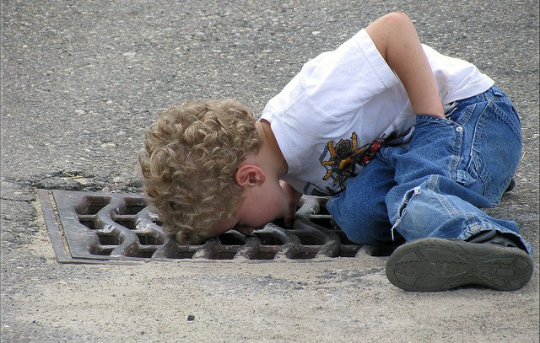
Qualitative Researcher as the Human Instrument

Slide 14
Are you ready to play?
I hope so!

Slide 15
Let the games begin!
Warm Up
Sesame Street: https://www.youtube.com/watch?v=gCxrkl2igGY
Puzzle
Highlights Double Check: https://www.highlightskids.com/games
Playing with your Food
Clue

Slide 16
About me
Ronald J. Chenail, Ph.D., is Associate Provost for Undergraduate Academic Affairs, Professor of Family Therapy, and Director of the Graduate Certificate in Qualitative Research Program at Nova Southeastern University (NSU).
Since 1990, he has been part of 14 grants and contracts totally over $6,506,300, published over 130 publications including seven books, and given over 190 formal academic presentations at conferences and meetings.
He is the editor-in-chief of The Qualitative Report and the Journal of Divorce and Remarriage.
ron@nova.edu

